Slide 1


CLAUDE COWORK 101

Slide 2




Claude Code & Claude Cowork
Claude code is an agentic AI coding tool that reads your codebase, edits files, runs commands, and autonomously works through problems.
Claude Cowork uses the same agentic architecture that powers Claude Code, now accessible within Claude Desktop and without opening the terminal.
Instead of responding to prompts one at a time, Claude can take on complex, multi-step tasks and execute them on your behalf.
© All rights reserved for Dr. Ryan Ahmed @Stemplicity Inc.
https://claude.com/product/cowork

Slide 3
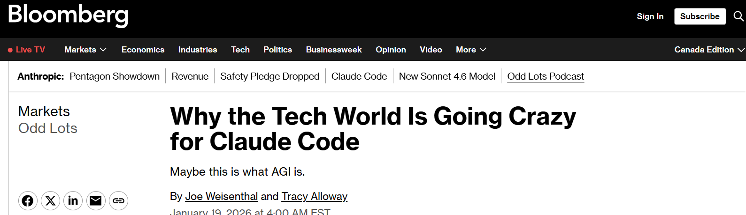
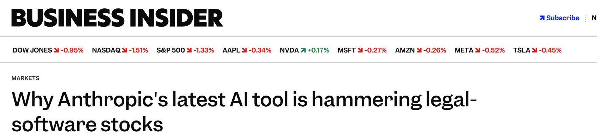

Claude Code & Cowork Frenzy!
© All rights reserved for Dr. Ryan Ahmed @Stemplicity Inc.

Slide 4
Quick Demo
© All rights reserved for Dr. Ryan Ahmed @Stemplicity Inc.
https://claude.com/product/cowork

Slide 5
AGENT SKILLS

Slide 6
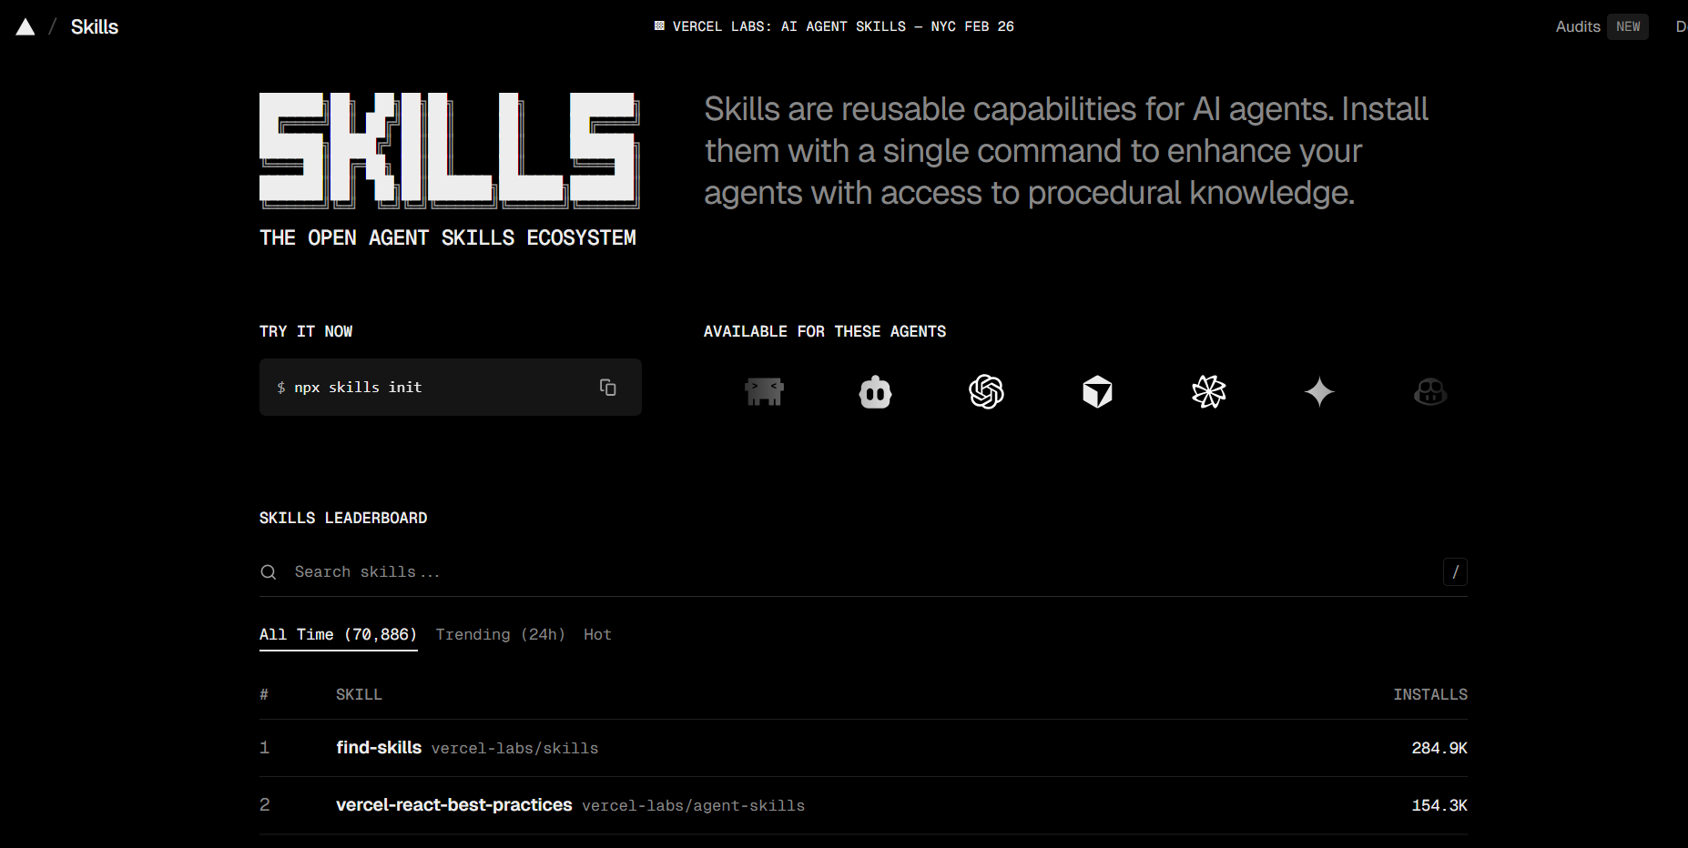
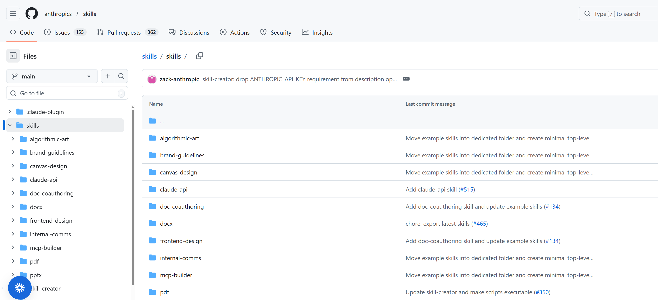
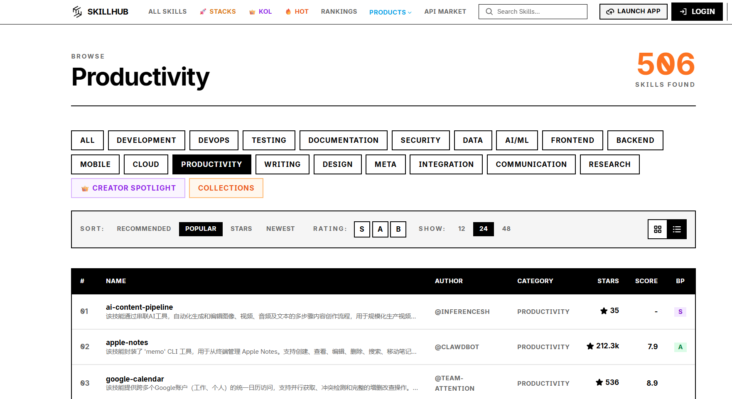
Skills Sources
Skills extend Claude's capabilities by giving it access to specialized knowledge and workflows. Create once, use everywhere. It’s summarized in a SKILL.md file.
https://skills.sh/
https://github.com/anthropics/skills/tree/main/skills
https://www.skillhub.club/
© All rights reserved for Dr. Ryan Ahmed @Stemplicity Inc.

Slide 7
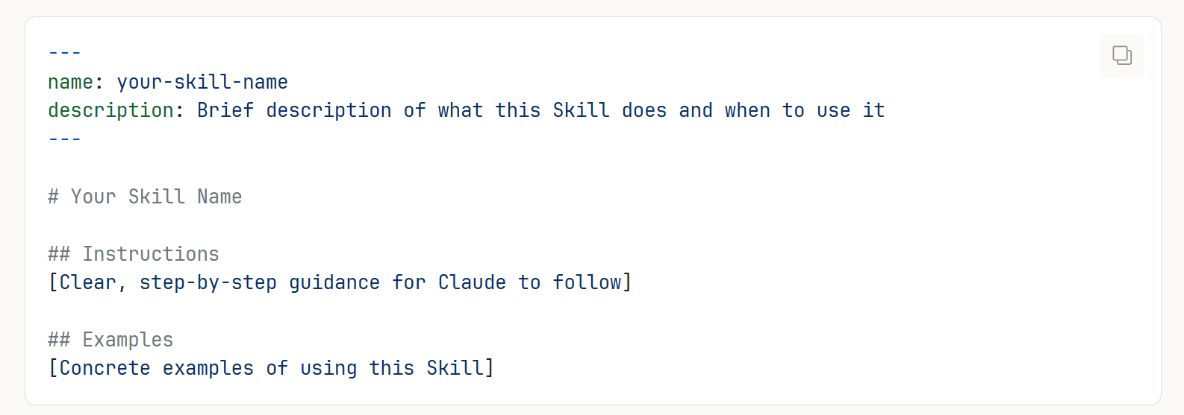
What does a Skill file look like?
Claude loads skills dynamically to improve performance on specialized tasks.
Every Skill requires a SKILL.md file.
Note that on the top of each SKILL.md file, there is metadata that describes what the skill does which includes name and description.
© All rights reserved for Dr. Ryan Ahmed @Stemplicity Inc.

Slide 8
Anthropic’s Official Skills
Check the official skills list: https://github.com/anthropics/skills/tree/main/skills
pptx
PowerPoint
xlsx
Excel
docx
Word
Create and edit .pptx presentations
Build spreadsheets, charts, and formulas
Generate and edit formatted .docx documents
© All rights reserved for Dr. Ryan Ahmed @Stemplicity Inc.
pdf
PDF
frontend-design
Create, fill, merge, and extract from PDFs
Production-grade UI with bold aesthetic choices

Slide 9
CLAUDE PLUG-INS

Slide 10





Plugins
Plugins bundle skills, connectors, slash commands & sub-agents into one package for a specific job function. No technical knowledge required to create them.
What's Inside a Plugin
Pre-Built Plugins
Skills: Specialized knowledge & workflows
HR: People operations & lifecycle
Connectors (MCP): Link to Google Drive, Slack, etc.
Design: UX, accessibility, critiques
© All rights reserved for Dr. Ryan Ahmed @Stemplicity Inc.
Engineering: Standups, deploys, incidents
Slash Commands: Quick-launch structured workflows
Operations: Runbooks, vendor evals
Sub-Agents: Specialized task executors
Finance: FP&A, variance analysis
Sales: Outreach, research, CRM

Slide 11
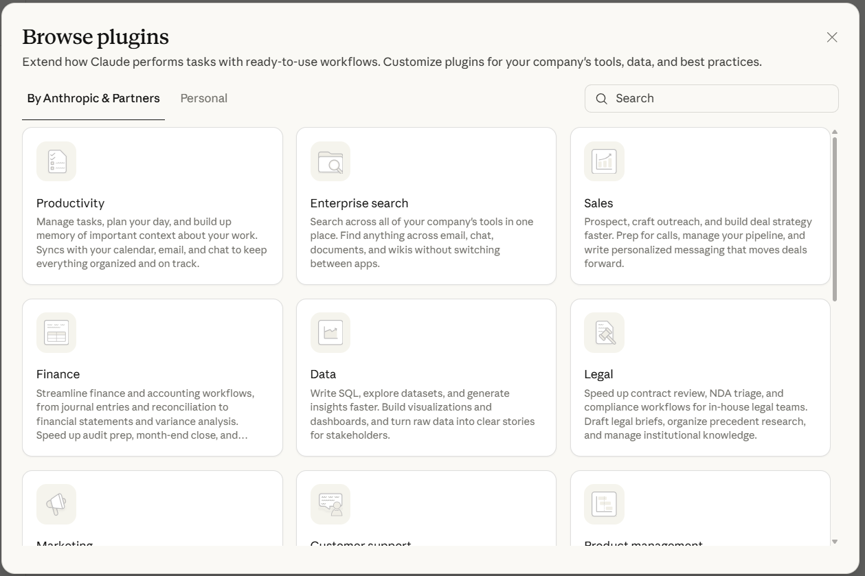
Available Claude Plugins
© All rights reserved for Dr. Ryan Ahmed @Stemplicity Inc.

Slide 12
Quick Demo
© All rights reserved for Dr. Ryan Ahmed @Stemplicity Inc.
https://claude.com/product/cowork

Slide 13

Practice Opportunity: Claude Plugins
Use the same saas_monthly_metrics.csv datasets:
Download the data plugin in Claude Cowork
Generate visuals and static plots
Summarize the results in a 5-slide PowerPoint presentation
© All rights reserved for Dr. Ryan Ahmed @Stemplicity Inc.

Slide 14
Thank you!

